Slide 1



Gurdon scRNA-seq data analysis workshop – day 1
Adam Reid
Head of Bioinformatics
Gurdon Institute
21st March 2023

Slide 2
Course setup
Install R and RStudio
If you do not already have R and Rstudio installed, follow the instructions:
https://posit.co/download/rstudio-desktop/
Install R packages
Open R studio and, in the console, run:
install.packages('Seurat’)
install.packages("sctransform")
install.packages("tidyr")
install.packages("dplyr")
Get dataset
You can download the data from DropBox (see course website)
Where these data are stored on your computer will affect some of the commands in the exercises!
Course website
https://adamjamesreid.github.io/gurdon-bioinformatics/docs/scrnaseq_workshop.html

Slide 3
Outline
Day 1
Background to scRNA-seq
CellRanger for mapping and read counts
QC – good and bad cells
Normalisation – why raw counts are misleading
Dimension reduction - high dimensional data are difficult to visualize
Batch effects - samples from different batches can have systematic differences that need removing
Clustering
The dataset
Cell Ranger demo
Exercises

Slide 4
Outline
Day 2
Recap
Identifying cell types
Differentially expressed genes
Your own data

Slide 5
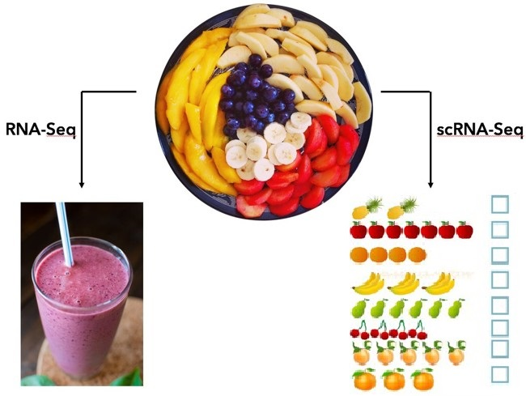
Bulk vs single cell RNA-seq
Average expression level
Comparative transcriptomics
Disease biomarker
Homogenous systems
Separate populations
- Define heterogeneity
- Identify rare cell populations
- Cell population dynamics
Notes:
flavours

Slide 6
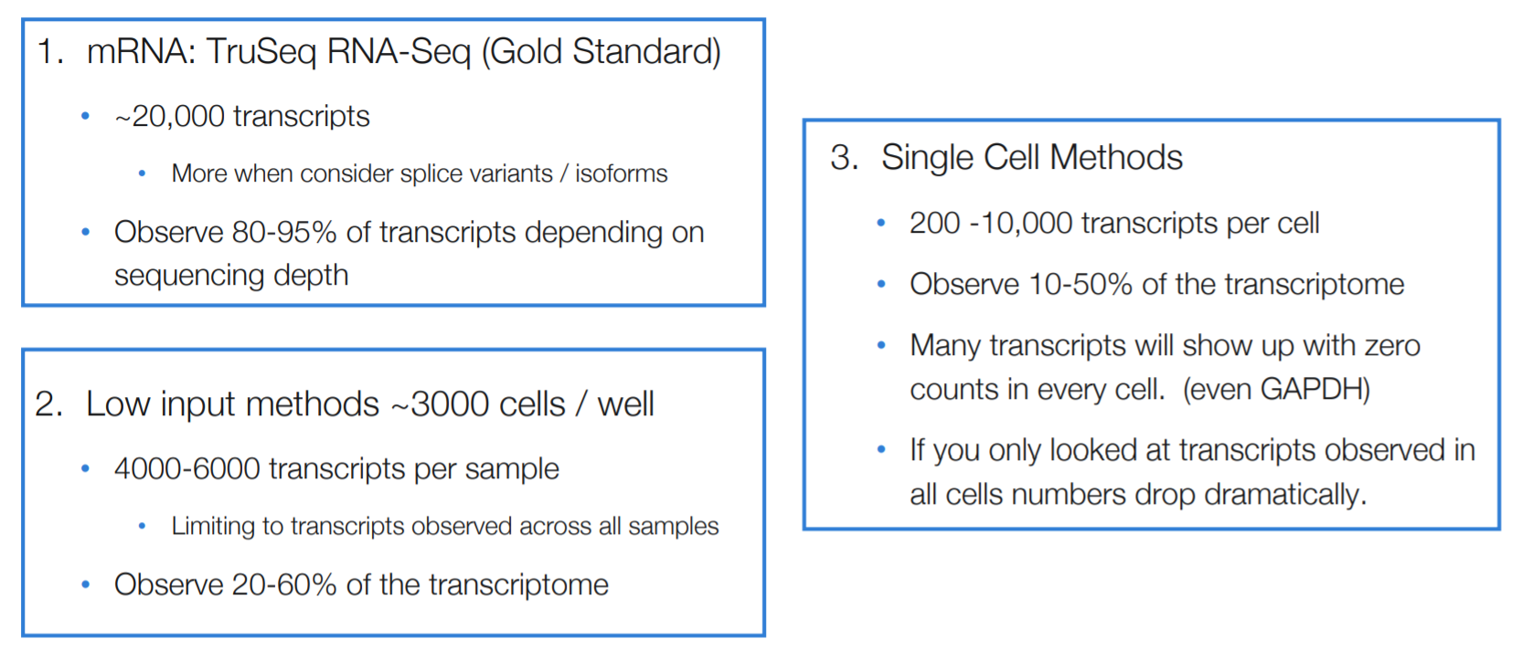
Bulk vs single cell rna-seq
1.
2.
Disadvantages of scRNA-seq
Dropouts and noisy data
Lowly expressed genes might be undetected
Samples will contain doublets
Replicates without batch effect are unlikely
Expensive
Source: Sarah Boswell, Harvard Medical School, September 2020
Notes:
Unravel tissue heterogeneity: Novel and rare cell types Unknown cellular states Transcriptional dynamics Can also measure single-cell: Chromatin accessibility Mutation & CNV (scDNAseq) Methylation Measures the average expression level for each gene across a large population of input cells
Useful for comparative transcriptomics, e.g. samples of the same tissue from different species
Useful for quantifying expression signatures from ensembles, e.g. in disease studies
Insufficient for studying heterogeneous systems, e.g. early development studies, complex tissues (brain)
Does not provide insights into the stochastic nature of gene expression
Measures the distribution of expression levels for each gene across a population of cells
Allows to study new biological questions in which cell-specific changes in transcriptome are important, e.g. cell type identification, heterogeneity of cell responses, stochasticity of gene expression, inference of gene regulatory networks across the cells.

Slide 7
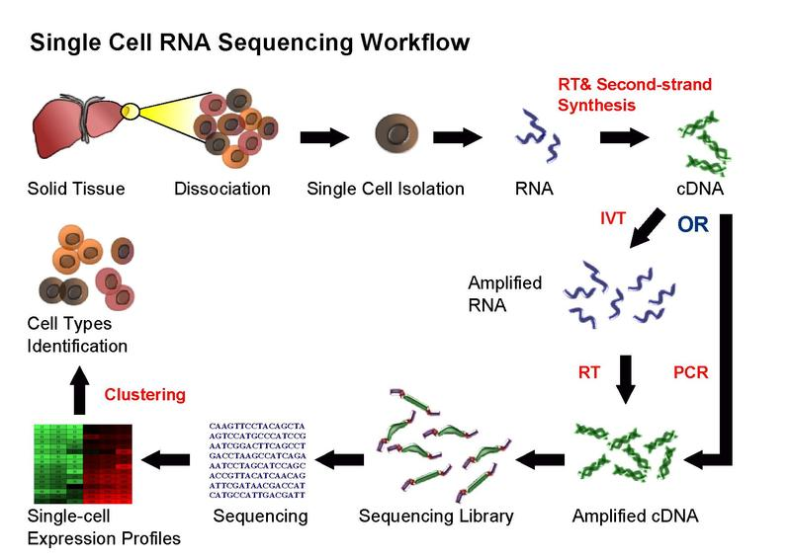

workflow
Good sample preparation is key to success!
Source: https://en.wikipedia.org/wiki/Single_cell_sequencing
Notes:
Dissociation can be easy (blood) or hard (collagenous tissue) Separation and RT differ by protocol
Cell isolation – FACS, nanowell, droplet, split barcoding
Library prep – polyA vs random priming, 3/5 bias vs full length, PCR vs in vitro trancscription
Sequencing – illumina, NanoPore
cDNA strand is used as a template for in vitro transcription (IVT). 1 The RNA polymerase produces multiple copies of antisense RNA (aRNA) with amplification factors of up to 1000-fold. Because of random priming to synthesize the second strand, the IVT products are not full-length copies, and the 5′-terminal sequences of the transcripts are underrepresented in the aRNA. T

Slide 8
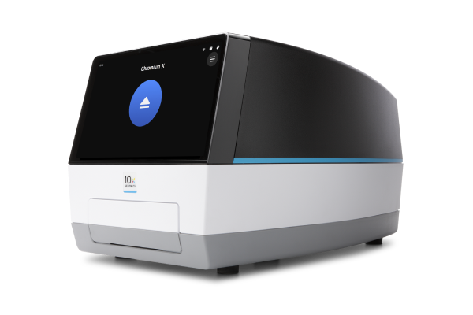
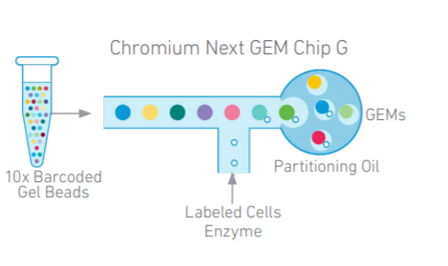
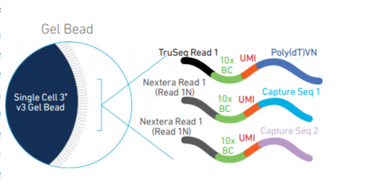
10x Genomics Chromium scRNA-seq platform overview
- Droplet-based capturing, either 3’ or 5’ mRNA
Uses soft gel beads containing oligos. These enable “single Poisson loading” leading to capture of >60% of input cells.
Standardized instrumentation and reagents (unhackable so no customisation or control)
Very easy to use and less processing time
More high-throughput scaling - 8 samples can be processed simultaneously with up to 10000 cells captured per sample
The doublet rate increases with number of cells loaded
CellRanger and CellLoupe software are available and user friendly
Source: 10x Genomics

Slide 9
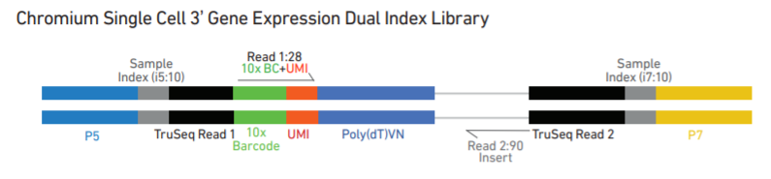
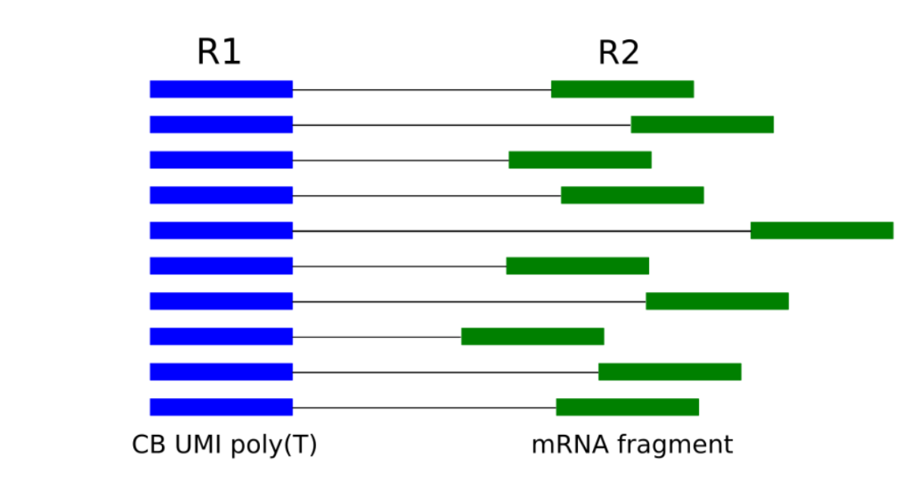
10X Chromium libraries
Source: 10x Genomics
Sequencing Read | Description | Number of cycles
Read1 | 10x Barcode Read (Cell) + Randomer Read (UMI) | 28bp
i7 index | Sample index read | 10bp
i5 index | Sample index read | 10bp
Read2 | Insert Read (Transcript) | 90bp

Slide 10
What platform Should I use?
Choose protocol based on:
- Throughput (number of cells per reaction)
- Sample of origin
- Cost / Labour / Time limitations
- Gene body coverage: 5’/ 3’ biased or full-length?
- UMI vs no-UMI
- Sequencing depth per cell
Examples:
If you sample is fairly homogeneous – bulk RNAseq
If your sample is limited in cell number – plate-based method
If you want re-annotate the transcriptome and discover new isoforms – full-length coverage (SMART-seq2, seqWell)
If you are looking to classify all cell types in a diverse tissue - high throughput
If you have only archival human samples – nuclei isolation

Slide 11
Experimental design
Firstly, what is the question?
Classifying the different cell types in a sample?
Rare/novel cell population?
Gene expression differences between particular cell types in different individuals/conditions?
Changes in cell number between conditions?
Changes in expression through development?
Replication
For some questions good replication is essential. For others it is advised.
The best statistical approaches for DE in scRNA-seq are the same as for bulk, so ideally triplicates.
The appropriate way to make replicates depends on your experiment and you should consult a bioinformatician to help with experimental design
How many cells per samples?
How rare is your rarest cell type of interest? How many cells might you need to compare cell numbers/gene expression levels in these cells?
N.b. the number of cells going into the experiment is much more than you will get out!
Sequencing depth
Aim for 100,000 reads per cell
Replication advised
Replication advised
Replication essential
Replication essential
Replication advised

Slide 12
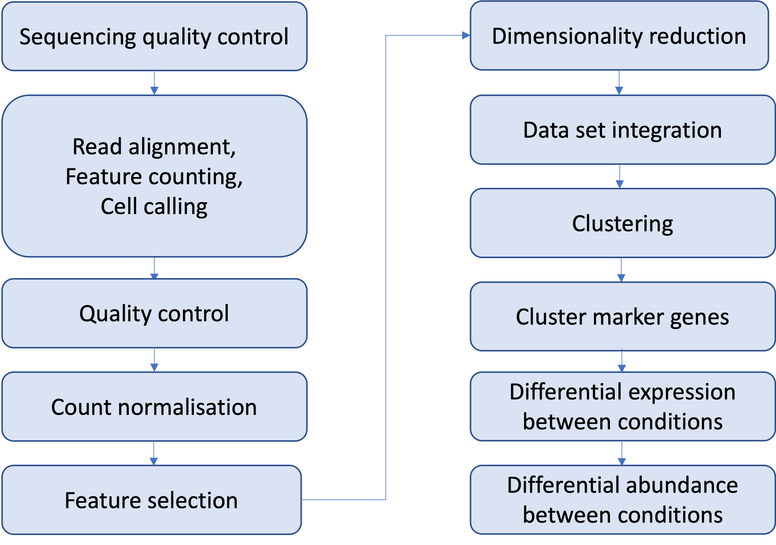
Analysis workflow

Slide 13
10X chromium library structure
The 10x library contains four pieces of information, in the form of DNA sequences:
sample index - identifies the library, with one or two indexes per sample
10x barcode - identifies the droplet in the library
UMI - identifies the transcript molecule within a cell and gene
insert - the transcript sequence
The sequences for any given fragment will generally be delivered in 3 or 4 files:
I1: I7 sample index
I2: I5 sample index if present (dual indexing only)
R1: 10x barcode + UMI
R2: insert sequence
<SampleName>_S<SampleNumber>_L00<Lane>_<Read>_001.fastq.gz
E.g.
SRR9264343_S0_L001_I1_001.fastq.gz SRR9264343_S0_L001_R1_001.fastq.gz SRR9264343_S0_L001_R2_001.fastq.gz

Slide 14
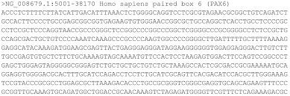
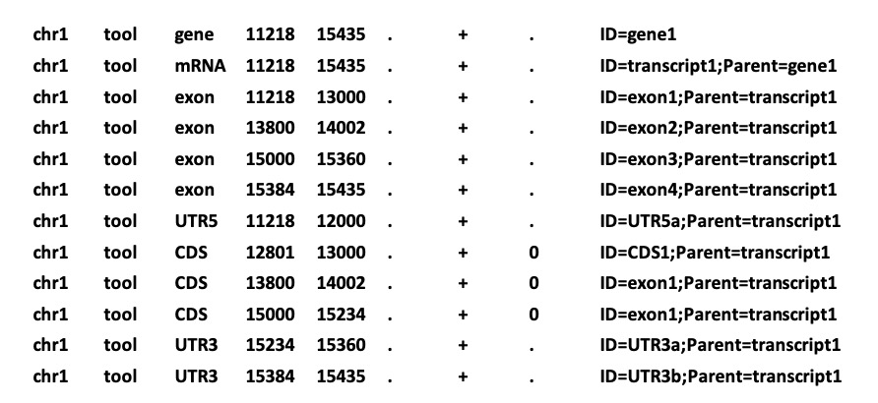
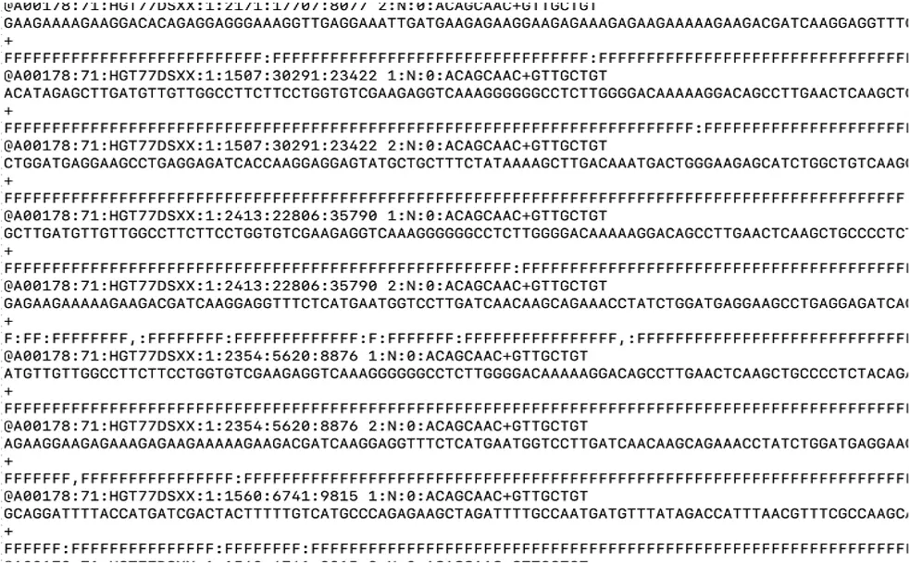
Mapping and counting reads
The reference sequence – fasta format
There are two popular sources of assembly files:
UCSC (hg19, hg38, mm10, etc)
GRC (GRCh37, GRCh38, GRCm38).
Major releases of UCSC and GRC assemblies are matched in main chromosomes (e.g. chr1 from hg38 = chr1 from GRCh38), but differ in additional contigs and so-called ALT loci, which change between minor releases
Reference annotation – gtf format
Popular sources of human and mouse genome annotation are RefSeq, ENSEMBL, and GENCODE. RefSeq is the most conservative of the three, and tends to have the fewest annotated transcripts per gene. RefSeq transcript IDs start with NM_ or NR, e.g. NM_12345.
ENSEMBL and GENCODE are very similar to each other and can be used interchangeably for our purposes. Gene names in these start with ENSG (for human) and ENSMUSG (for mouse); transcripts start with ENST and ENSMUST, respectively.
Reads – fastq format

Slide 15
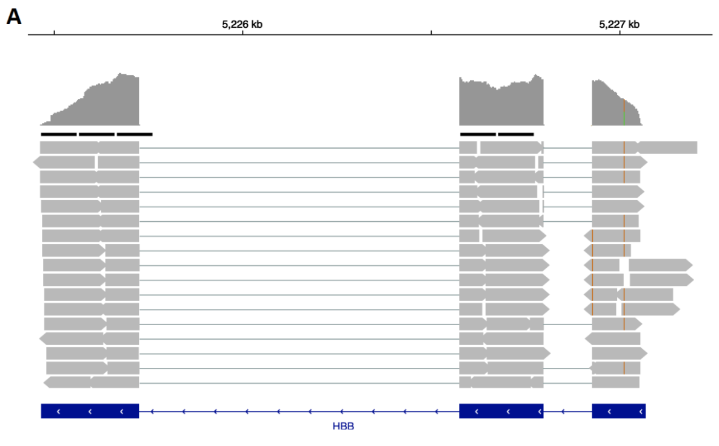
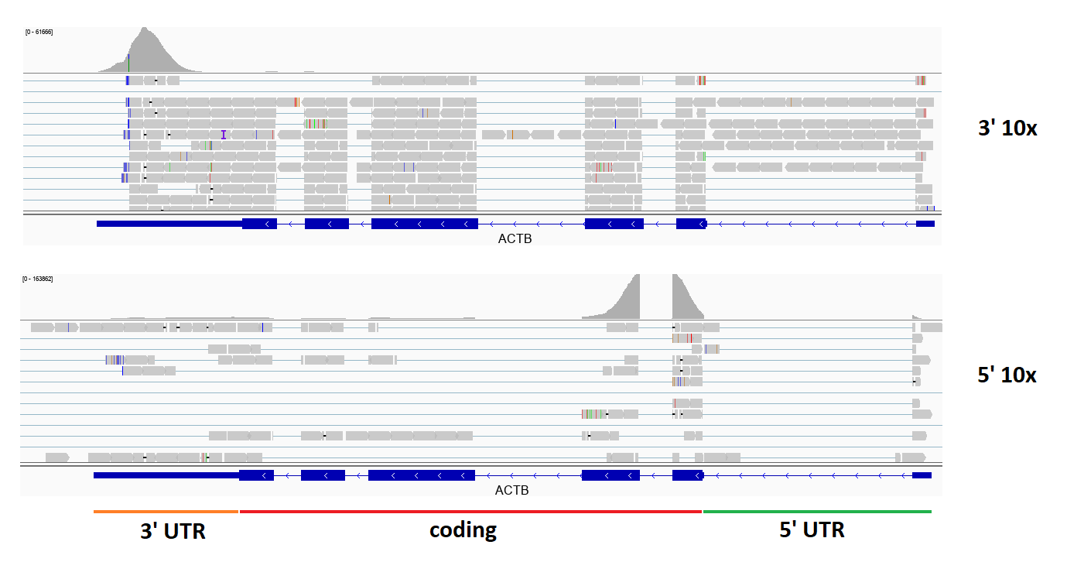
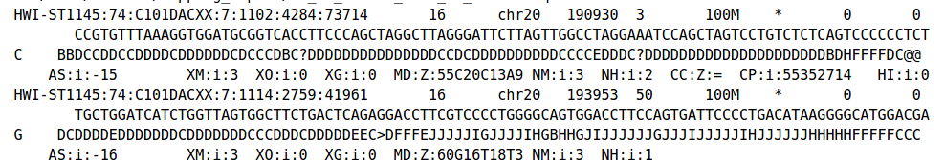
Mapping and counting reads
Bulk RNA-seq
3’ and 5’ 10X scRNA-seq
Read counts are stored in a count matrix
Mapped reads are stored in BAM files

Slide 16
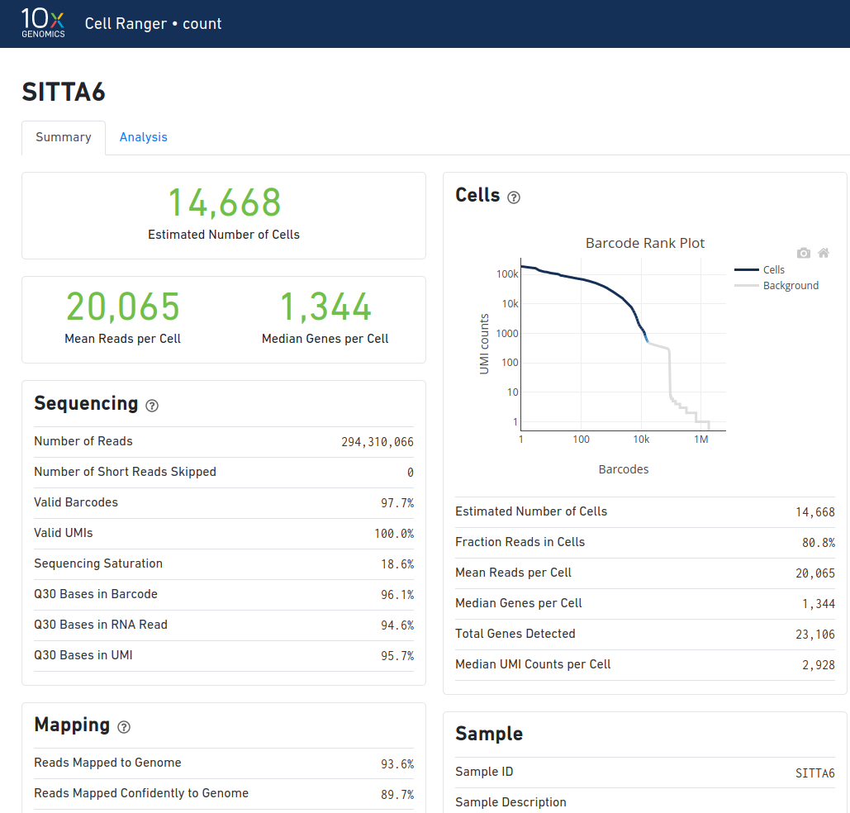
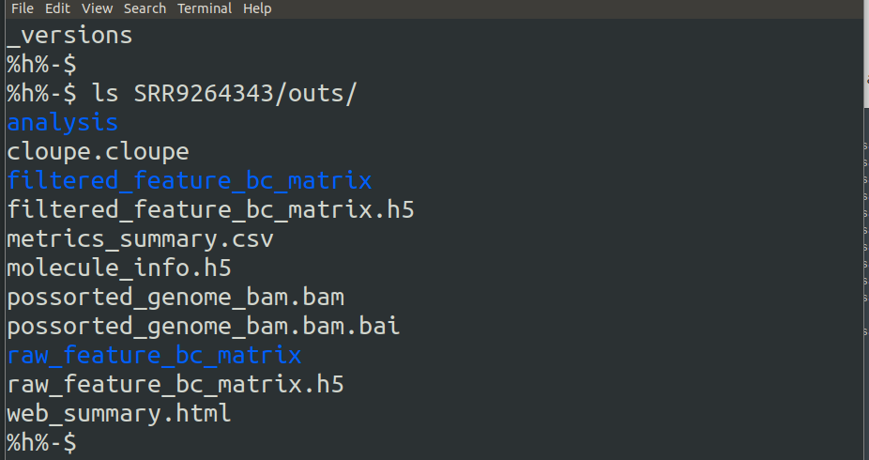
Cell Ranger outputs

Slide 17
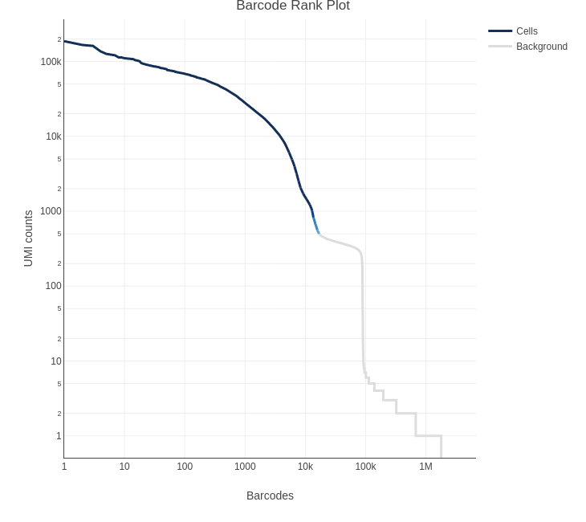
Cell Ranger cell calling

Slide 18
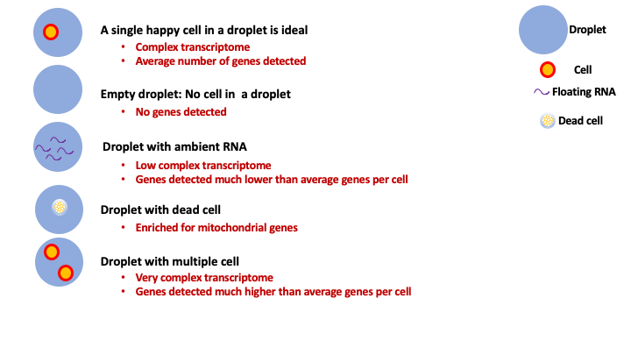
Quality Control - QC
Aim of QC is:
To remove undetected genes
To remove empty droplets
To remove droplets with dead cells
To remove Doublet/multiplet cells
Ultimately to filter the data to only include true cells that are of high quality
This is achieved by applying cut-offs on:
Number of genes detected per cell
Percent of mitochondrial genes per cell
Number of UMIs/transcripts detected per cell

Slide 19
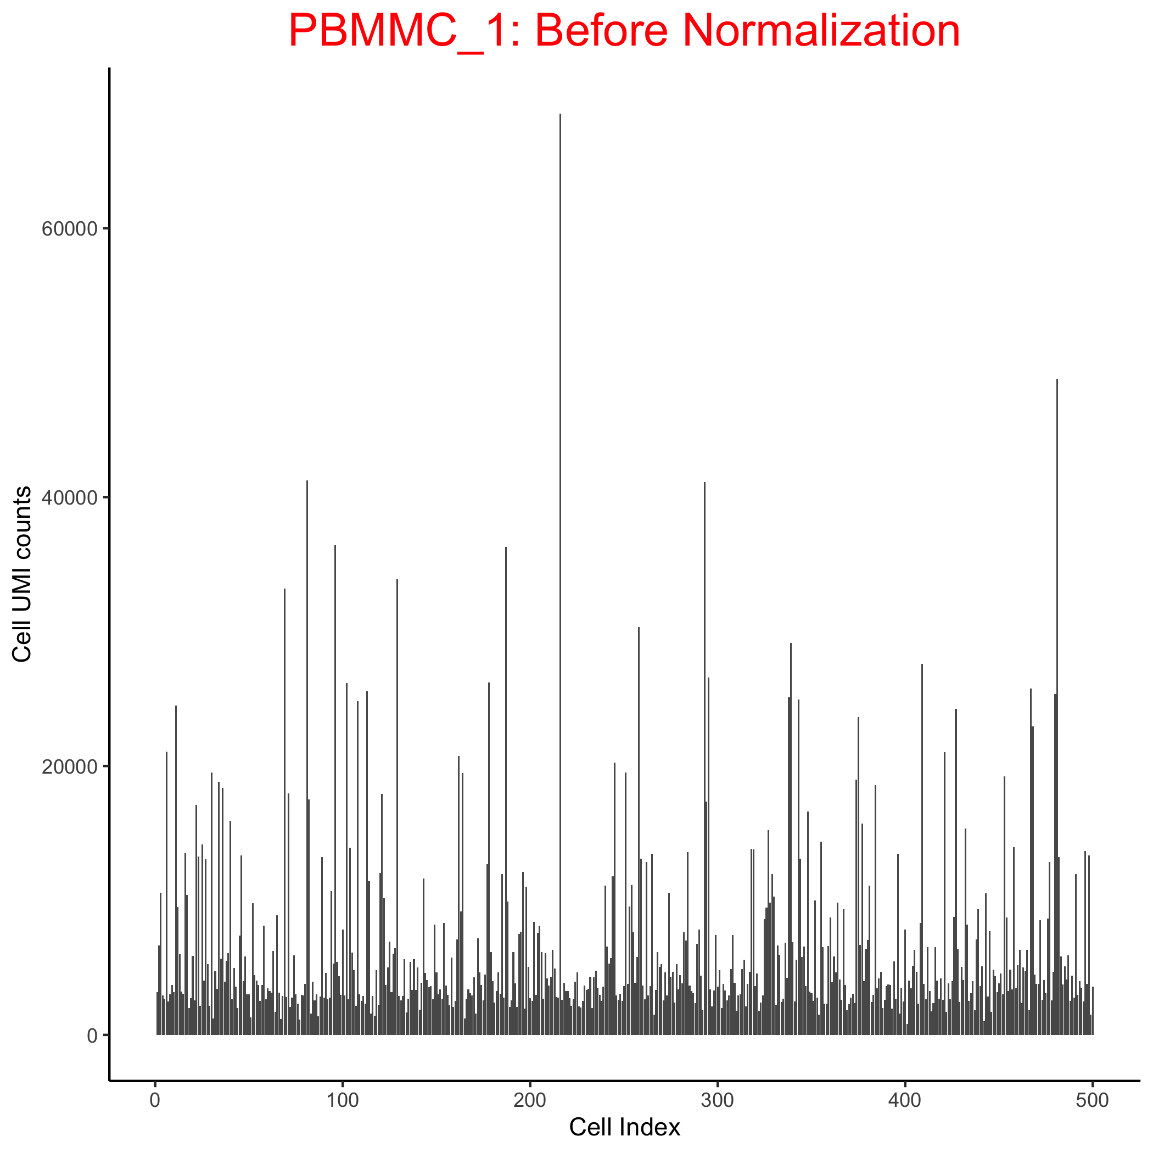
Normalisation
We derive biological insights downstream by comparing cells against each other.
But the UMI count differences makes it harder to compare cells.
Why do total transcript molecules (UMI counts) differ between cells?
Biological: - Cell type differences: size, transcriptional activity
Technical:
- scRNA data is inherently noisy - Low mRNA content per cell - Cell-to-cell differences in mRNA capture efficiency
- Variable sequencing depth - PCR amplification efficiency
Normalization reduces technical differences to increase the relative strength of biological differences, allowing meaningful comparison of expression profiles between cells.

Slide 20
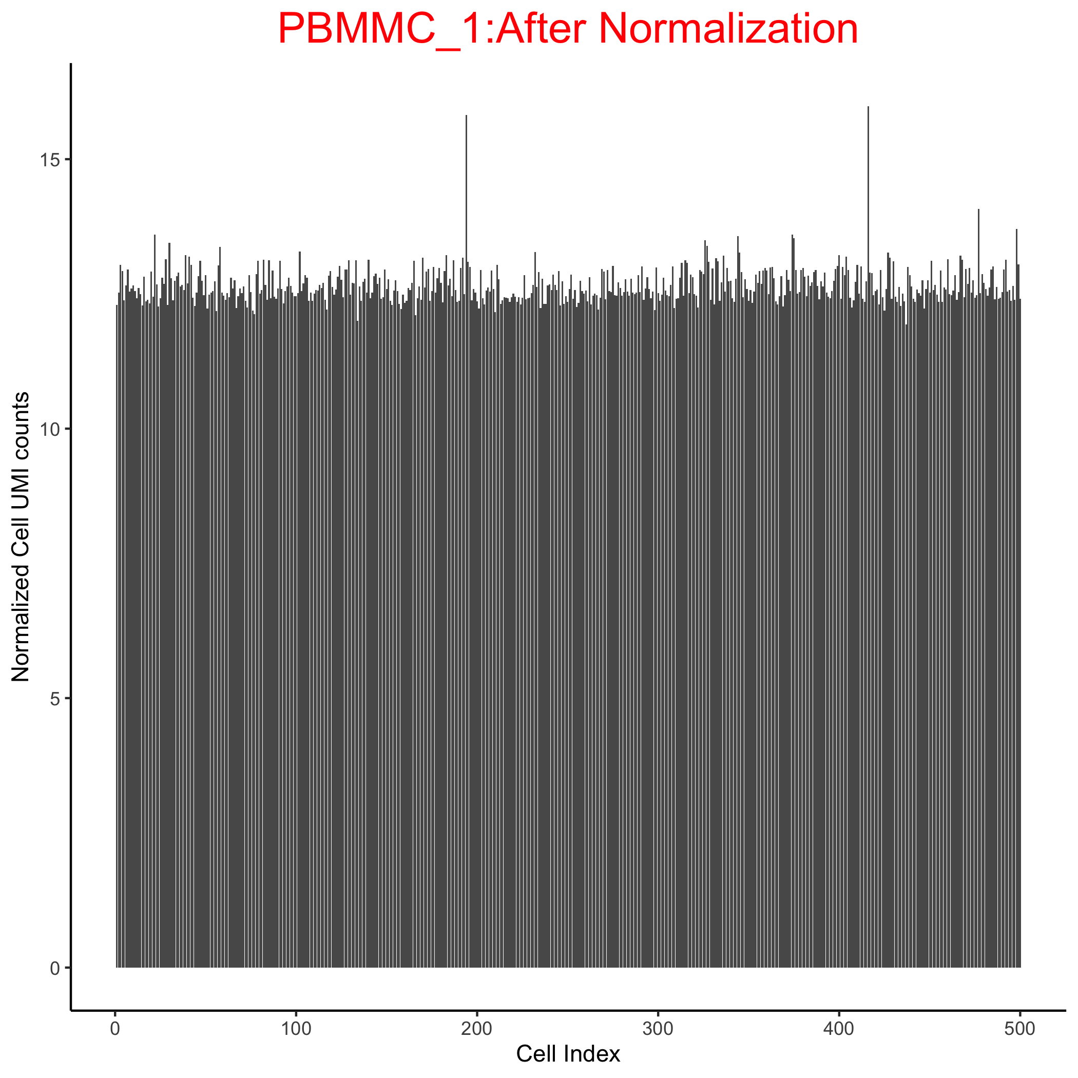
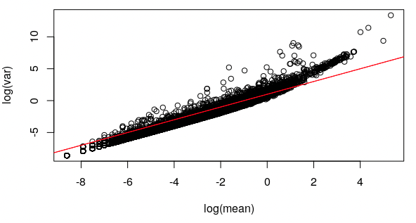
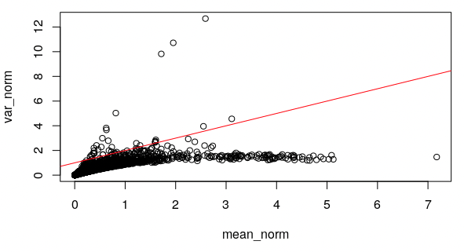
Normalisation – general principle
Normalization has two steps:
1. Scaling – correct depth bias (and composition bias)
Calculate size factors or normalization factors that represents the relative depth bias in each cell
Scale the counts for each gene in each cell by dividing the raw counts by a size factor
2. Transformation – correct mean-variance bias
log2 (e.g. Deconvolution)
Pearson residuals (eg. sctransform)
Normalisation approaches used for bulk RNA-seq are not appropriate for scRNA-seq. Here we use scTransform, which takes care of scaling and transformation for single-cell RNA-seq data
scTransform does both steps in one by regressing on library size and taking the Pearson residuals!

Slide 21

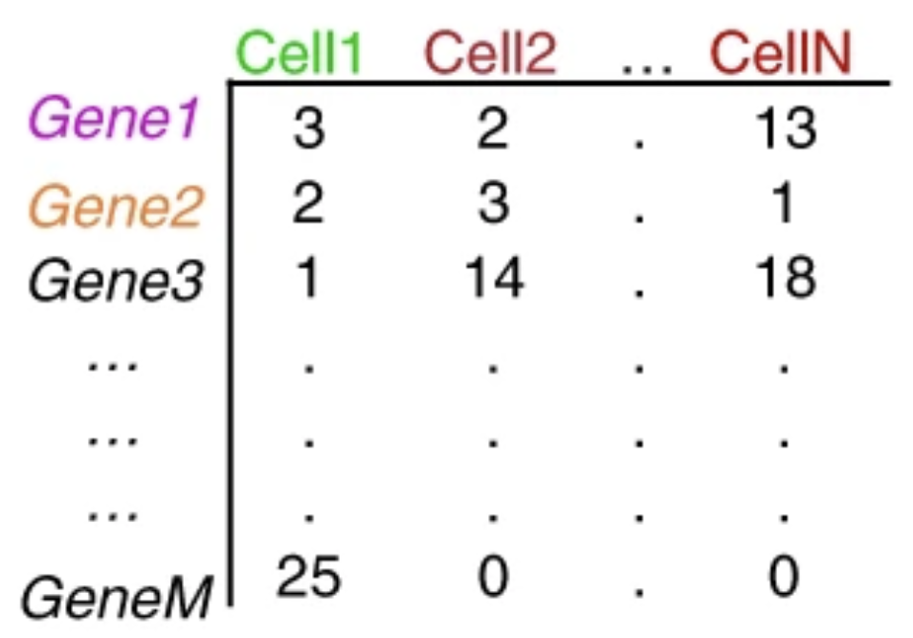
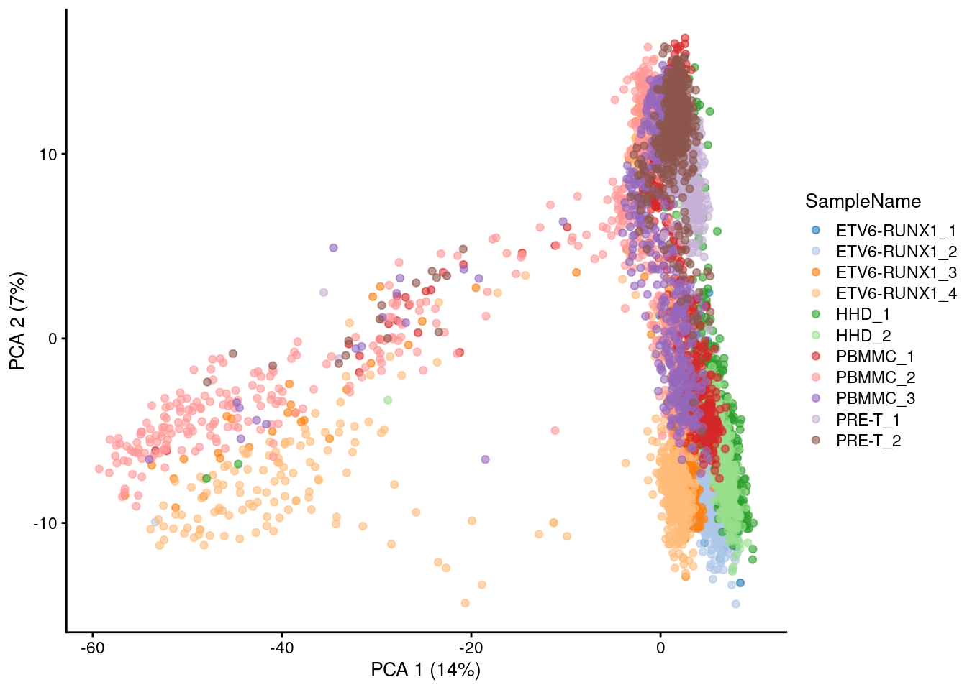
Dimension reduction
scRNA-seq data are high dimensional i.e. can be represented by a number of dimensions equal to the number of genes. But I can’t see in 30,000 dimensions!
Not all 30,000 dimensions are useful – many have little or no information. Some contain the same information as others.
Identify the highly variable genes (HVGs) – those which are “doing something” in the data
Principal components analysis (PCA) – find a smaller number of linear paths through the n dimensions which capture as much variation in gene expression as possible, each across multiple genes. PC1 has the most variance of any PC, PC2 the next most…. We might select 10 or 20 PCs, instead of 30,000 genes.

Slide 22
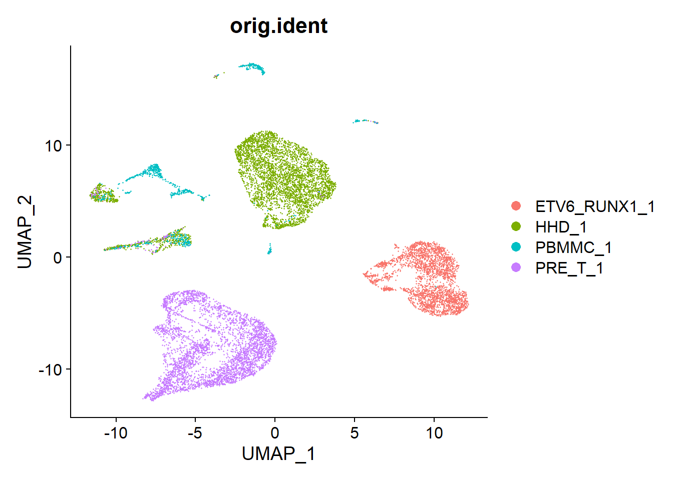
Dimension reduction - UMAP
Non-linear graph-based dimension reduction method like t-SNE
Better than PCA at showing overall similarities of cells
Preserves the global structure better than t-SNE
Newer & efficient = fast
Based on the top Principal Components
TIPS:
Worth exploring the parameters e.g. n_neighbours
Set a seed so you don’t get different results each time!

Slide 23
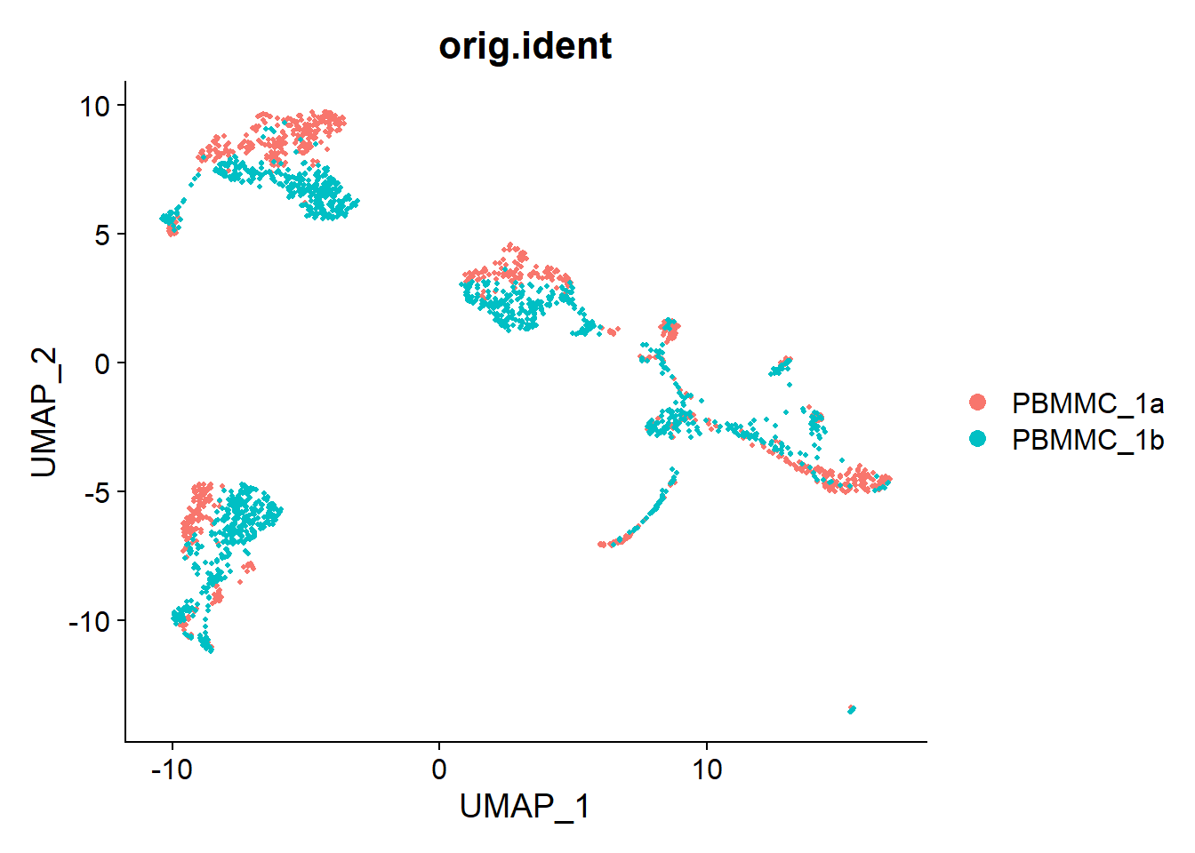
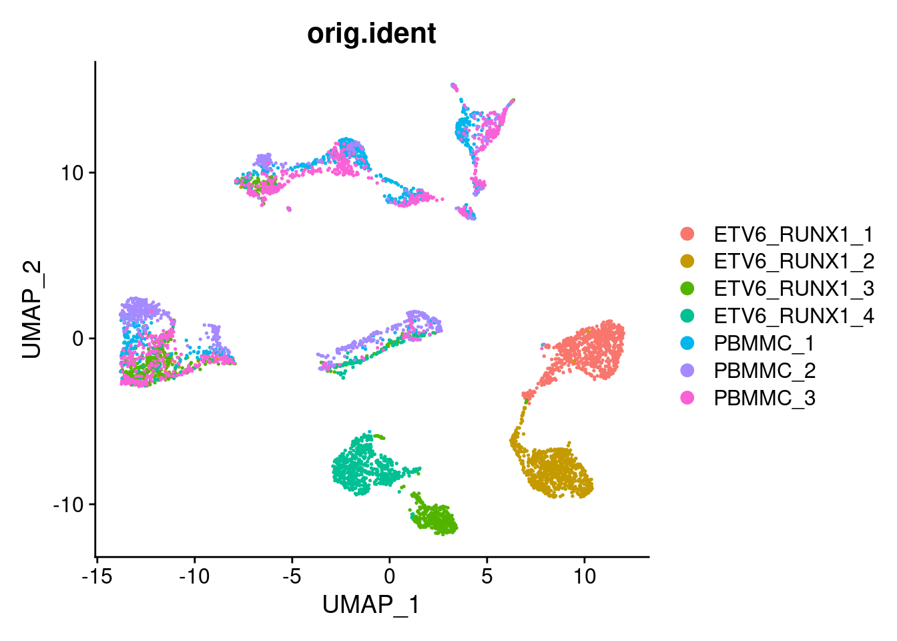
Batch effects
Batch effect between technical replicates
Batch effect between different samples
UMI counts, which have been corrected for batches cannot be used for gene-level analysis i.e. differential expression and marker identification. They are only suitable for cell-level analysis e.g. clustering.

Slide 24
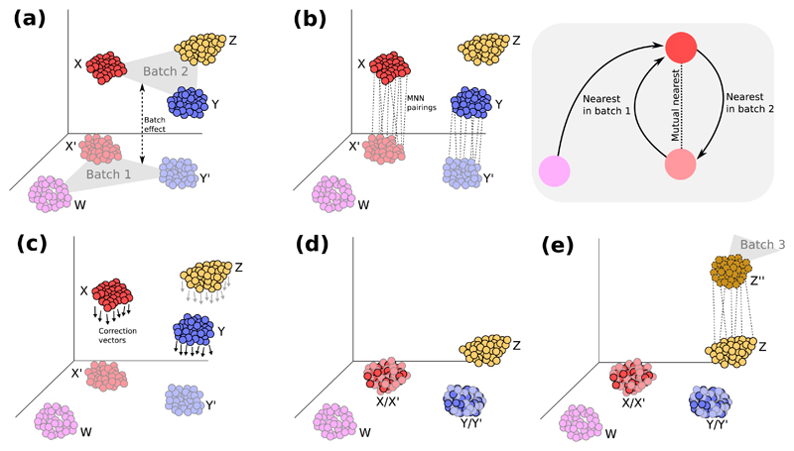
Batch effects – mutual nearest neighbours
Here are the assumptions of this approach (taken from Haghverdi et al 2018):
There is at least one cell population that is present in both batches
the batch effect is not correlated to the biological effect
the batch-effect variation is much smaller than the biological-effect variation between different cell types
The “integration anchors” approach in Seurat is based on this Mutual Nearest Neighbours approach of Haghverdi et al.

Slide 25
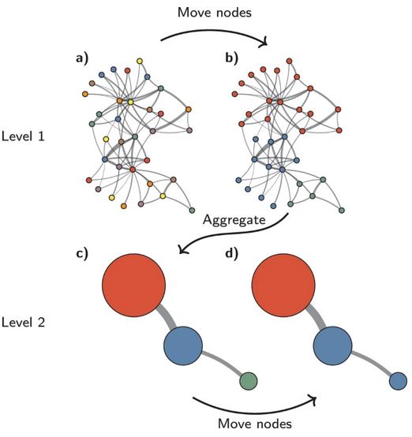
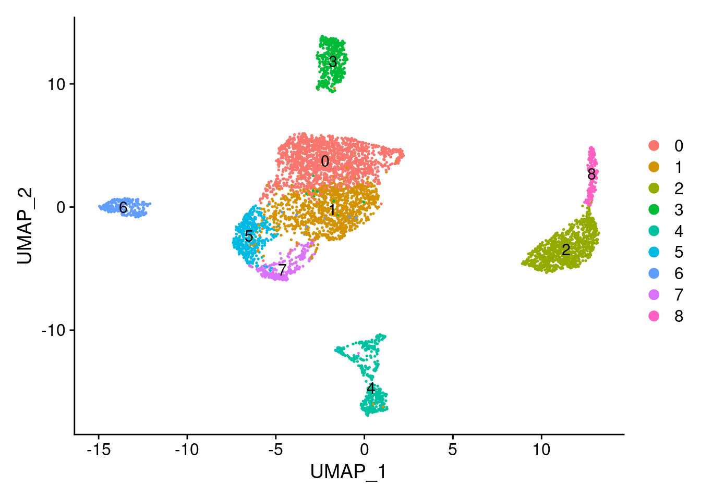
Clustering
The data has been QC’d, normalized, and batch corrected.
We can now start to understand the dataset by identifying cell types.
This involves two steps:
unsupervised clustering: identification of groups of cells based on the similarities of the transcriptomes without any prior knowledge of the labels usually using the PCA output
annotation of cell-types based on transcription profiles
TIPS:
It is worth trying different algorithms and parameters for each algorithm as it is difficult to know which will work best for your data

Slide 26
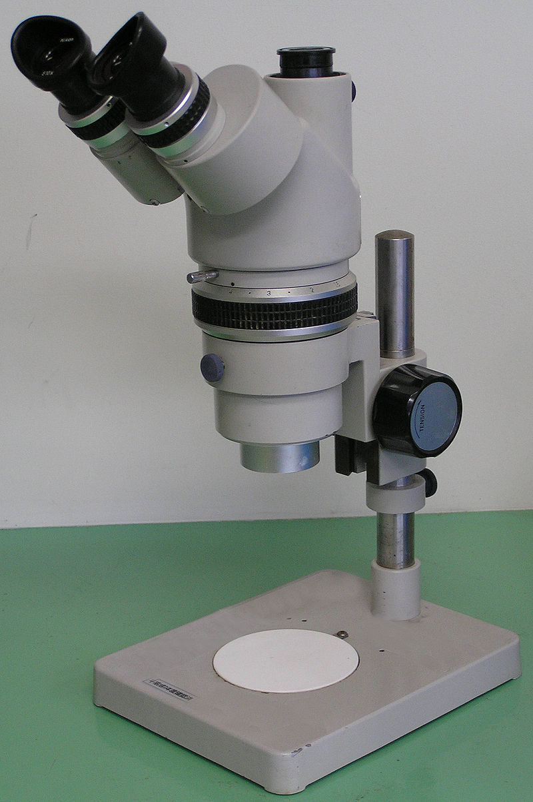
Is there a “correct” clustering?
Clustering, like a microscope, is a tool to explore the data.
We can zoom in and out by changing the resolution of the clustering parameters, and experiment with different clustering algorithms to obtain alternative perspectives on the data.
Asking for an unqualified “best” clustering is akin to asking for the best magnification on a microscope.
A more relevant question is “how well do the clusters approximate the cell types or states of interest?”. Do you want:
resolution of the major cell types?
Resolution of subtypes?
Resolution of different states (e.g., metabolic activity, stress) within those subtypes?
Explore the data, use your biological knowledge!

Slide 27
The Dataset
Childhood acute lymphoblastic leukemia (cALL) is the most common pediatric cancer. The aim of the study was to characterise the heterogeneity of gene expression at the cell level, within and between patients.
Caron et al. 2020
loaded thawed PBMMCs onto a 10X Genomics Chromium single cell platform (v2 chemistry).
They aimed for 3,000 cells per sample and targeted 100,000 reads per cell by sequencing each sample on one lane of an Illumina HiSeq 4000 high-throughput sequencer (2x98 b.p. paired-end sequencing).
They generated single cell gene expression data from 39,375 pediatric bone marrow mononuclear cells (PBMMCs) from eight cALL patients of common subtypes.
Thus we have cells collected from four patients with ETV6/RUNX1 rearrangements, two HHD cases and two T-ALL cases. There are also PBMMCs from 3 healthy donors.
In the original paper they examined transcriptional variation within and between the cancers of different patients. Similarly, by the end of this workshop we will have:
Performed QC, normalisation and batch correction on the data.
Identified the cell types in the different samples and looked at DE genes.

Slide 28
Analysis software
Popular options
Seurat - R
Bioconductor (scater/scran) - R
Scanpy – Python
They all do similar things but with different data structures and/or programming languages.
Sometimes the tool you want to use will be implemented in one or other “ecosystem”. You can usually convert your data into alternative format and proceed, but you might have to use a different language. Look for tutorials online!

Slide 29
The Seurat object
@meta.data slot - stores metadata for our droplets/cells (e.g. which batch of samples they belong to, total counts, total number of detected genes, etc.).
@assays slot - stores the matrix of raw counts ($RNA), as well as matrices of normalised ($SCT) and transformed data ($integrated).
@reductions slot – stores dimension reductions such as pca ($pca) and umap ($umap)

Slide 30
Cell Ranger demo
# run mkref
cellranger mkref \
--fasta=Homo_sapiens.GRCh38.dna.chromosome.21.fa \
--genes=gencode.v41.primary_assembly.annotation.chr21.gtf \
--genome=cellranger_index_human \
--nthreads=7
# run cellranger count (maximum CPUs 8; maximum RAM 24GB)
cellranger count \
--id=ETV6_RUNX1_rep1 \
--transcriptome=cellranger_index_human \
--fastqs=/mnt/scratch/reid/ajr236/SRR9264343/ \
--sample=SRR9264343 \
--localcores=8 \
--localmem=24

Slide 31
Acknowledgements
Lots of slides on scRNA-seq - Katarzyna Kania
Various course materials - Abigail Edwards, Ashley D Sawle, Chandra Chilamakuri, Kamal Kishore, Stephane Ballereau, Zeynep Kalendar Atak, Hugo Tavares, Jon Price, Roderik Kortlever, Adam Reid, Tom Smith
Data for CellRanger demo - Sumru Bayin

Slide 32
Cell Ranger demo
# run mkref
cellranger mkref \
--fasta=Mus_musculus.GRCm39.dna.chromosome.19.fa\
--genes=Mus_musculus.GRCm39.109.chr19.gtf \
--genome=cellranger_index \
--nthreads=7
# run cellranger count (maximum CPUs 8; maximum RAM 24GB)
cellranger count \
--id=P1_1_mapping \
--transcriptome=cellranger_index \
--fastqs=. \
--sample=P1 \
--localcores=8 \
--localmem=24

Slide 33
Top tips for bioinformatics success
If you think you might be doing a lot of R, Python etc. go on a 3-5 day course. It will save you a lots of time in the future.
If you have been on a course before but don’t remember anything, go again.
If you don’t like courses or can’t find one, get an introductory programming book and put 2-3 days aside to do nothing but work through it.
A large part of any technical work is knowing what to Google and how to interpret the results
Read the error messages thoroughly
Google these error messages
Read through several pages of Google results discussing these error messages

